Slide 1
CLOUDS PI
SINHGAD COLLEGE OF ENGINEERING, DEPARTMENT OF COMP. ENGINEERING, STCL 2019-20.
1
Notes:
1

Slide 2
Defining Raspberry Pi
The Raspberry Pi is a low cost, credit-card sized computer that plugs into a computer monitor or TV, and uses a standard keyboard and mouse.
The Raspberry Pi has the ability to interact with the outside world, and has been used in a wide array of digital maker projects, from music machines and parent detectors to weather stations and tweeting birdhouses with infra-red cameras.
SINHGAD COLLEGE OF ENGINEERING, DEPARTMENT OF COMP. ENGINEERING, STCL 2019-20.
2

Slide 3
Cloud Computing
Cloud Computing refers to manipulating, configuring, and accessing the applications online. It offers online data storage, infrastructure and application.
Cloud Computing is both a combination of software and hardware based computing resources delivered as a network service.
Cloud Computing provides us a means by which we can access the applications as utilities, over the Internet. It allows us to create, configure, and customize applications online.
SINHGAD COLLEGE OF ENGINEERING, DEPARTMENT OF COMP. ENGINEERING, STCL 2019-20.

Slide 4
Problem Statement
Study of a Low-Cost Raspberry-Pi-Based Micro Datacenter for Software- Defined Cloud Computing
SINHGAD COLLEGE OF ENGINEERING, DEPARTMENT OF COMP. ENGINEERING, STCL 2019-20.
4

Slide 5
Concepts of Cloud Computing
There are certain services and models working behind the scene making the cloud computing feasible and accessible to end users. Following are the working models for cloud computing:
1. Deployment Models
2. Service Models
SINHGAD COLLEGE OF ENGINEERING, DEPARTMENT OF COMP. ENGINEERING, STCL 2019-20.
5

Slide 6
Deployment Models
Deployment models define the type of access to the cloud, i.e., how the cloud is located? Cloud can have any of the four types of access: Public, Private, Hybrid and Community.
PUBLIC CLOUD : The Public Cloud allows systems and services to be easily accessible to the general public. Public cloud may be less secure because of its openness, e.g., e-mail.
PRIVATE CLOUD : The Private Cloud allows systems and services to be accessible within an organization. It offers increased security because of its private nature.
SINHGAD COLLEGE OF ENGINEERING, DEPARTMENT OF COMP. ENGINEERING, STCL 2019-20.

Slide 7
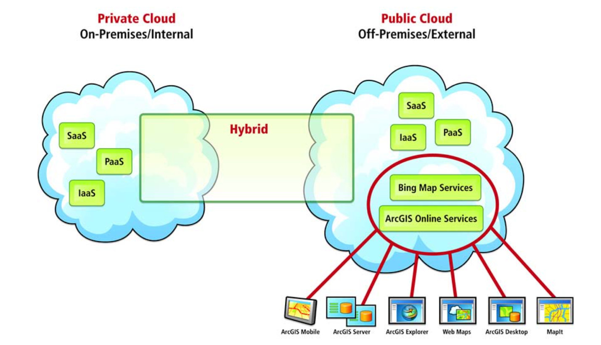
SINHGAD COLLEGE OF ENGINEERING, DEPARTMENT OF COMP. ENGINEERING, STCL 2019-20.

Slide 8
Service Models
Service Models are the reference models on which the Cloud Computing is based. These can be categorized into three basic service models as listed below:
1.Infrastructure as a Service (IaaS) : IaaS is the delivery of technology infrastructure as an on demand scalable service.
2. Platform as a Service (PaaS) : PaaS provides the runtime environment for applications, development & deployment tools, etc.
3. Software as a Service (SaaS) : SaaS model allows to use software applications as a service to end users. SaaS is a software delivery methodology that provides licensed multi-tenant access to software and its functions remotely as a Web-based service.
SINHGAD COLLEGE OF ENGINEERING, DEPARTMENT OF COMP. ENGINEERING, STCL 2019-20.

Slide 9
Motivation, Objectives, Outcomes
The need for agile, flexible, and cost-efficient computer networks has formed the nucleus for the global efforts toward software-defined networking (SDN).
The aim of this research is to develop a cloud computing project, where the users can use their external hard drive’s connected to Raspberry Pi through internet they can have access to anywhere from any device.
SDN not only reduces the complexity seen in today’s cloud datacenter networks but also helps cloud providers manage net- work services from a central management point.
SINHGAD COLLEGE OF ENGINEERING, DEPARTMENT OF COMP. ENGINEERING, STCL 2019-20.
9

Slide 10
Software Defined Networking
Software-defined networking (SDN) technology is an approach to network management that enables dynamic, programmatically efficient network configuration in order to improve network performance and monitoring making it more like cloud computing than traditional network management.
SDN is meant to address the fact that the static architecture of traditional networks is decentralized and complex while current networks require more flexibility and easy troubleshooting. SDN attempts to centralize network intelligence in one network component by disassociating the forwarding process of network packets (data plane) from the routing process (control plane).
SINHGAD COLLEGE OF ENGINEERING, DEPARTMENT OF COMP. ENGINEERING, STCL 2019-20.

Slide 11
Software Defined Networking
SDN was commonly associated with the OpenFlow protocol.However, since 2012 OpenFlow for many companies is no longer an exclusive solution, they added proprietary techniques.
SDN can create and control a virtual network or control a traditional hardware network with software.
While network virtualization enables the ability to segment different virtual networks within one physical network or connect devices on different physical networks into one virtual network, software-defined networking enables a new way of controlling the routing of data packets through a centralized server.
SINHGAD COLLEGE OF ENGINEERING, DEPARTMENT OF COMP. ENGINEERING, STCL 2019-20.

Slide 12
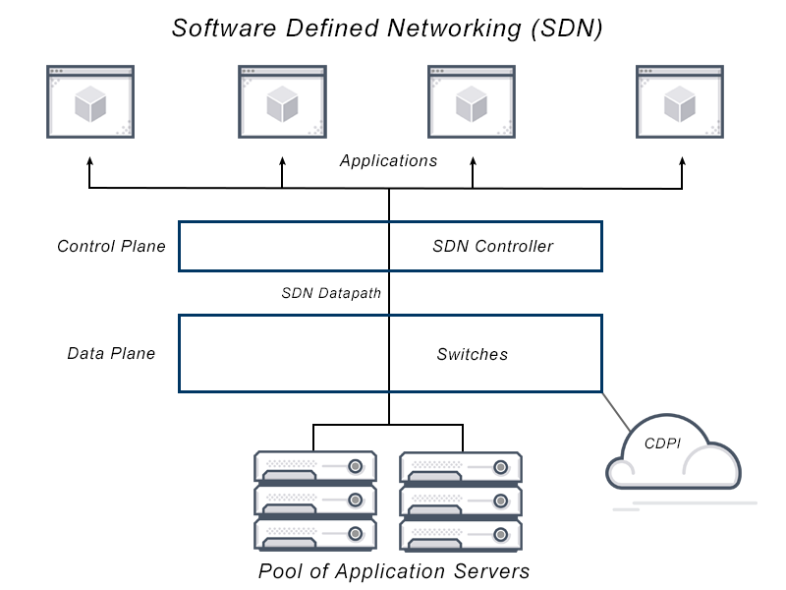
SINHGAD COLLEGE OF ENGINEERING, DEPARTMENT OF COMP. ENGINEERING, STCL 2019-20.

Slide 13
Software Defined Networking
Data Plane: processing and delivery of packets Based on state in routers and endpoints E.g., IP, TCP, Ethernet, etc.
Control Plane: establishing the state in routers Determines how and where packets are forwarded Routing, traffic engineering, firewall state, ...
Separate control plane and data plane entities Have programmable data planes—maintain, control and program data plane from a central entity i.e. control plane software called controller. An architecture to control not just a networking device but an entire network.
SINHGAD COLLEGE OF ENGINEERING, DEPARTMENT OF COMP. ENGINEERING, STCL 2019-20.

Slide 14
How does it work?
Here are the SDN basics: In SDN (like anything virtualized), the software is decoupled from the hardware. SDN separates the two network device planes, moving the control plane that determines where to send traffic to software, and leaving the data plane that actually forwards the traffic in the hardware. This allows network administrators who use software-defined networking to program and control the entire network via a single pane of glass instead of on a device by device basis.
There are three parts to a typical SDN architecture:
Applications, which communicate resource requests or information about the network as a whole
Controllers, which use the information from applications to decide how to route a data packet
Networking devices, which receive information from the controller about where to move the data
SINHGAD COLLEGE OF ENGINEERING, DEPARTMENT OF COMP. ENGINEERING, STCL 2019-20.

Slide 15
How does it work?
These three elements may be located in different physical locations.
Physical or virtual networking devices actually move the data through the network. In some cases, virtual switches, which may be embedded in either the software or the hardware, take over the responsibilities of physical switches and consolidate their functions into a single, intelligent switch. The switch checks the integrity of both the data packets and their virtual machine destinations and moves the packets along.
SINHGAD COLLEGE OF ENGINEERING, DEPARTMENT OF COMP. ENGINEERING, STCL 2019-20.

Slide 16
Benefits of software-defined networking (SDN)
Cost reduction
Intelligent global connections
Granular security
Reduced downtime
SINHGAD COLLEGE OF ENGINEERING, DEPARTMENT OF COMP. ENGINEERING, STCL 2019-20.

Slide 17
How is SDN different from traditional networking?
The key difference between SDN and traditional networking is infrastructure: SDN is software-based, while traditional networking is hardware-based. Because the control plane is software-based, SDN is much more flexible than traditional networking. It allows administrators to control the network, change configuration settings, provision resources, and increase network capacity—all from a centralized user interface, without adding more hardware.
There are also security differences between SDN and traditional networking. Thanks to greater visibility and the ability to define secure pathways, SDN offers better security in many ways. However, because software-defined networks use a centralized controller, securing the controller is crucial to maintaining a secure network, and this single point of failure represents a potential vulnerability of SDN.
SINHGAD COLLEGE OF ENGINEERING, DEPARTMENT OF COMP. ENGINEERING, STCL 2019-20.

Slide 18
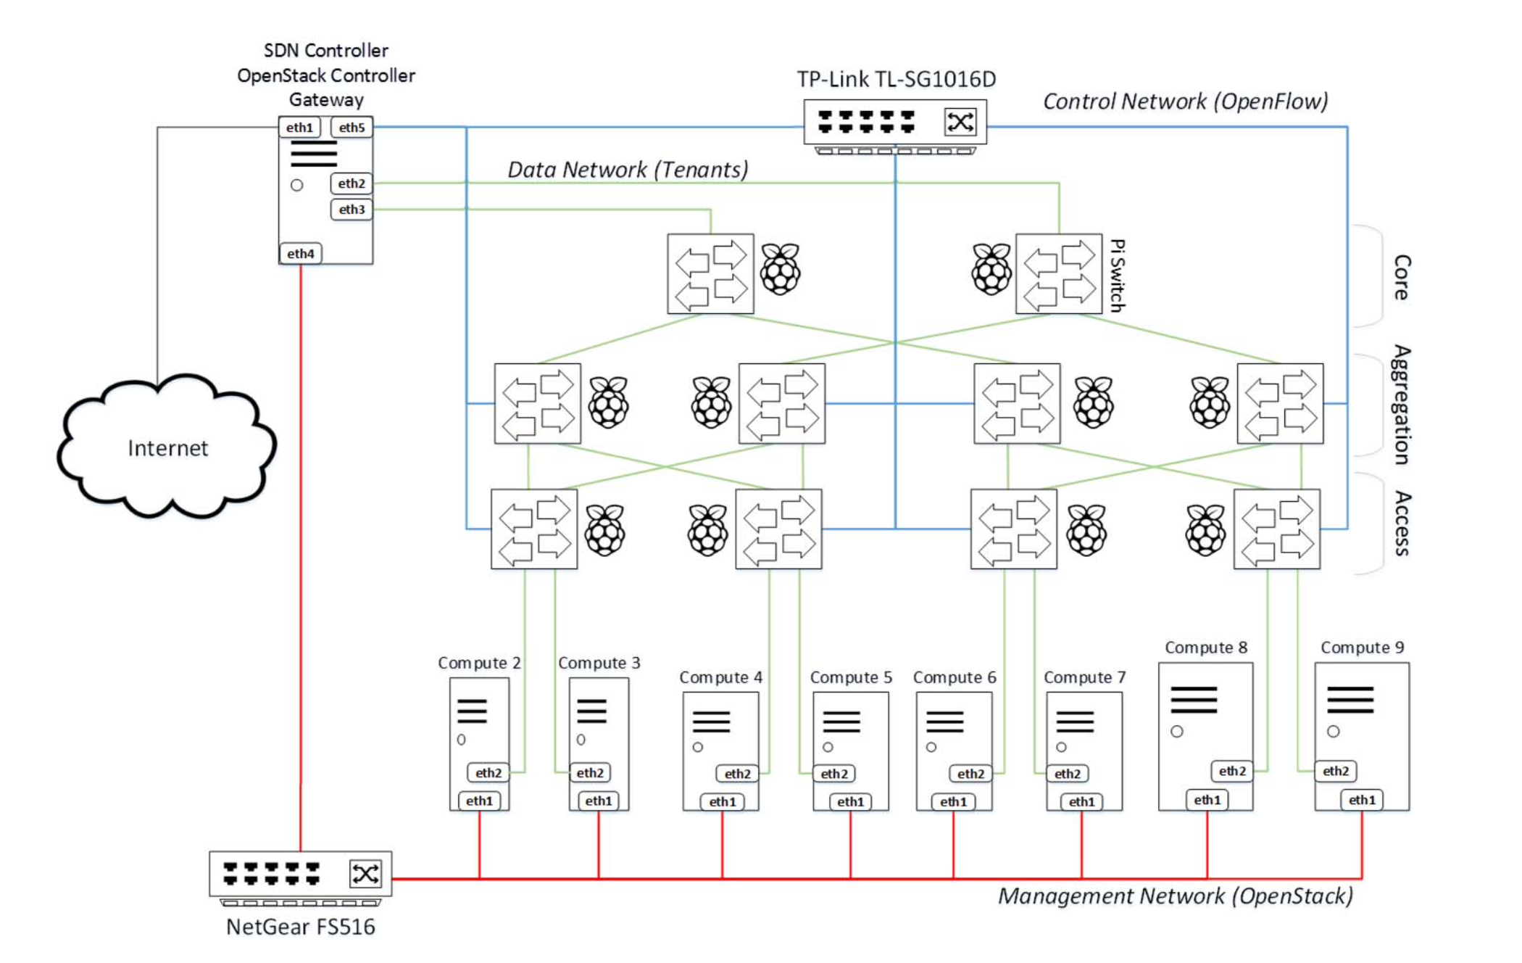
System Architecture of SDN
SINHGAD COLLEGE OF ENGINEERING, DEPARTMENT OF COMP. ENGINEERING, STCL 2019-20.

Slide 19
Layers of SDN
Infrastructure layer: it is the foundation layer consists of both physical and virtual network devices such as switches and routers. All the network devices will implement OpenFlow protocol to implement traffic forwarding rules.
Control layer: This layer consists of a centralized control plane that is decoupled from the physical infrastructure to provide centralized global view to entire network. The layer will use OpenFlow protocol to communicate with below layer i.e. infrastructure layer.
Application layer: it consists of network services, application and orchestration tools that are used to interact with control layer. It provide an open interface to communicate with other layers in the architecture.
SINHGAD COLLEGE OF ENGINEERING, DEPARTMENT OF COMP. ENGINEERING, STCL 2019-20.

Slide 20
Dynamic Flow Scheduling
Datacenter network topologies such as fat trees typically consist of many equal-cost paths between any given pair of hosts. Traditional network forwarding protocols often select a single deterministic path for each pair of source and destination, and sometimes protocols such as equal-cost multipath (ECMP) routing 11 are used to evenly distribute the load on multiple paths. This static mapping of flows to paths does not take into account network utilization and the duration of flows. We propose and demonstrate the feasibility of building dynamic flow scheduling for a given pair of hosts in our multirooted-tree testbed using ODL APIs.
SINHGAD COLLEGE OF ENGINEERING, DEPARTMENT OF COMP. ENGINEERING, STCL 2019-20.

Slide 21
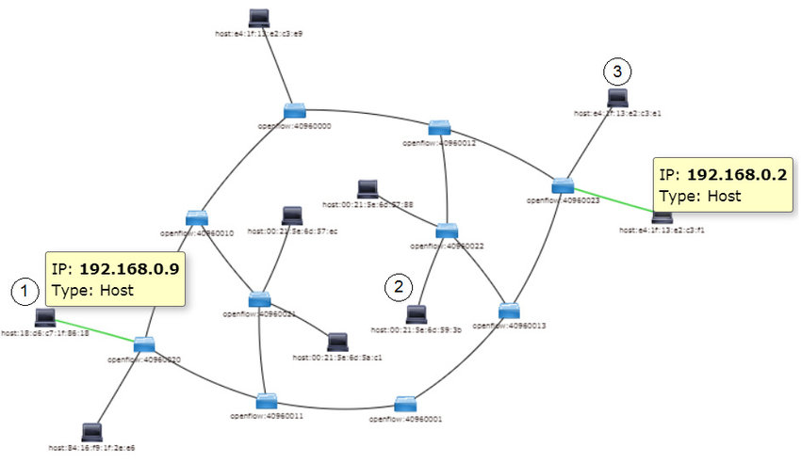
SINHGAD COLLEGE OF ENGINEERING, DEPARTMENT OF COMP. ENGINEERING, STCL 2019-20.

Slide 22
Virtual-Machine Management
Live migration, one of the core concepts in modern datacenters, allows moving a running VM between physical hosts with no impact on the VM’s availability. While VMs in datacenters are often migrated between hosts to reduce energy consumption or for maintenance purposes, live VM migration also provides an opportunity to enhance link utilization and reduce network-wide communication costs. This can be done by relocating communicating VMs to nearby hosts with fewer connecting links in the higher layers of the datacenter network topology.
SINHGAD COLLEGE OF ENGINEERING, DEPARTMENT OF COMP. ENGINEERING, STCL 2019-20.

Slide 23
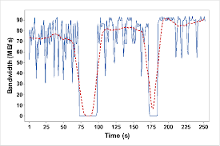
SINHGAD COLLEGE OF ENGINEERING, DEPARTMENT OF COMP. ENGINEERING, STCL 2019-20.

Slide 24
Conclusion
SDN promises to transform today’s static networks into flexible ,scalable, programmable platforms with the intelligence to allocate resources dynamically.
With its many advantages and astonishing industry momentum, SDN is on the way to become- the new approach for networking.
*
SINHGAD COLLEGE OF ENGINEERING, DEPARTMENT OF COMP. ENGINEERING, STCL 2019-20.
24

Slide 25
References
Research Papers :
https://ieeexplore.ieee.org/document/8497015
https://www.researchgate.net/publication/331975048_Raspberry_Pi_Personal_Cloud_Storage
SINHGAD COLLEGE OF ENGINEERING, DEPARTMENT OF COMP. ENGINEERING, STCL 2019-20.
25

Slide 26
Thank You!
Guided By
Prof. Dr. Jayashree Rajesh Prasad
SCOE, Pune
Presented By
Prashant Kumar
(305139)
SINHGAD COLLEGE OF ENGINEERING, DEPARTMENT OF COMP. ENGINEERING, STCL 2019-20.
25

